Slide 1
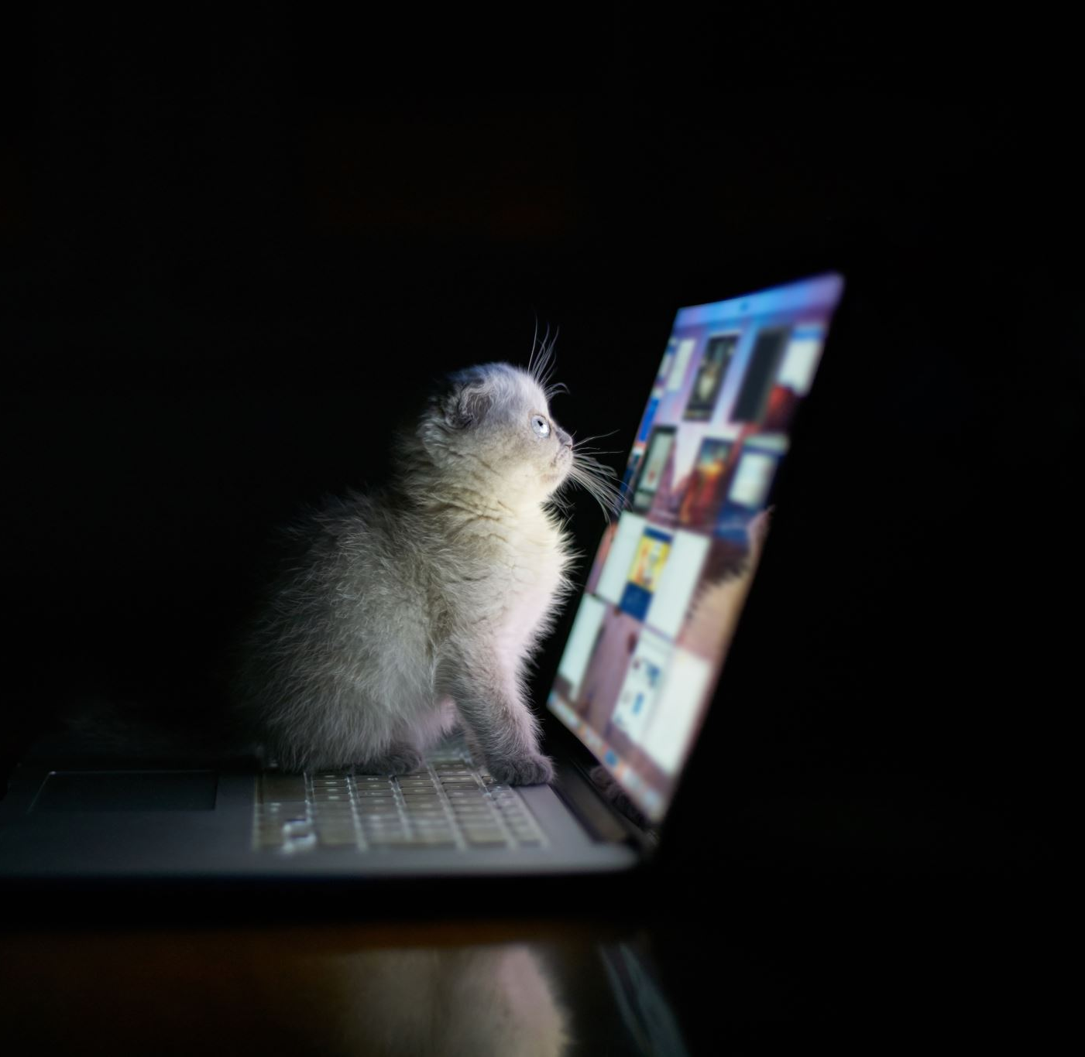
Computer and Mobile Crimes
Dr. Iftikhar Alam
Associate Professor
CUSIT

Slide 2
Basic terminologies
Computer?
Operating Systems
Android
Windows
Linux/Unix
Mac
Password: Strong/Weak passwords/Patterns for touch displays

Slide 3
Other computer attacks
Viruses and worms (Already discussed)
Hacking/Cracking
Trojan Horses
Timebombs

Slide 4
Cont…
Ransom ware (locking/unlocking of files)
Registry damages
Adware
Spyware
Bots

Slide 5
Cont…
Rootkits (for mobiles)
Terms (Rooting/Jailbreaking)
Key Loggers (apps)

Slide 6
Mobile Crimes
Privacy leakages
Data leakages (memory cards)
Pattern and password issues
Money and data transfers issues
SIM card issues
Malicious Apps issues

Slide 7
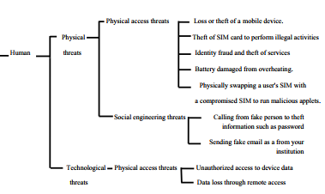
Cont…

Slide 8
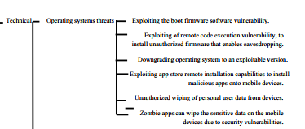
Cont…

Slide 9
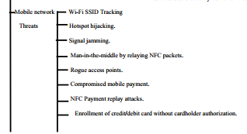
Cont…

Slide 10
Cont…
iOS
Android
Harmony OS
MeeGO (Linux-base open source)

Slide 11

Cont…
App stores
In-App purchases issues
Games (live games, friendships, etc.)
IMEI tempering
Mobile used in crimes

Slide 12
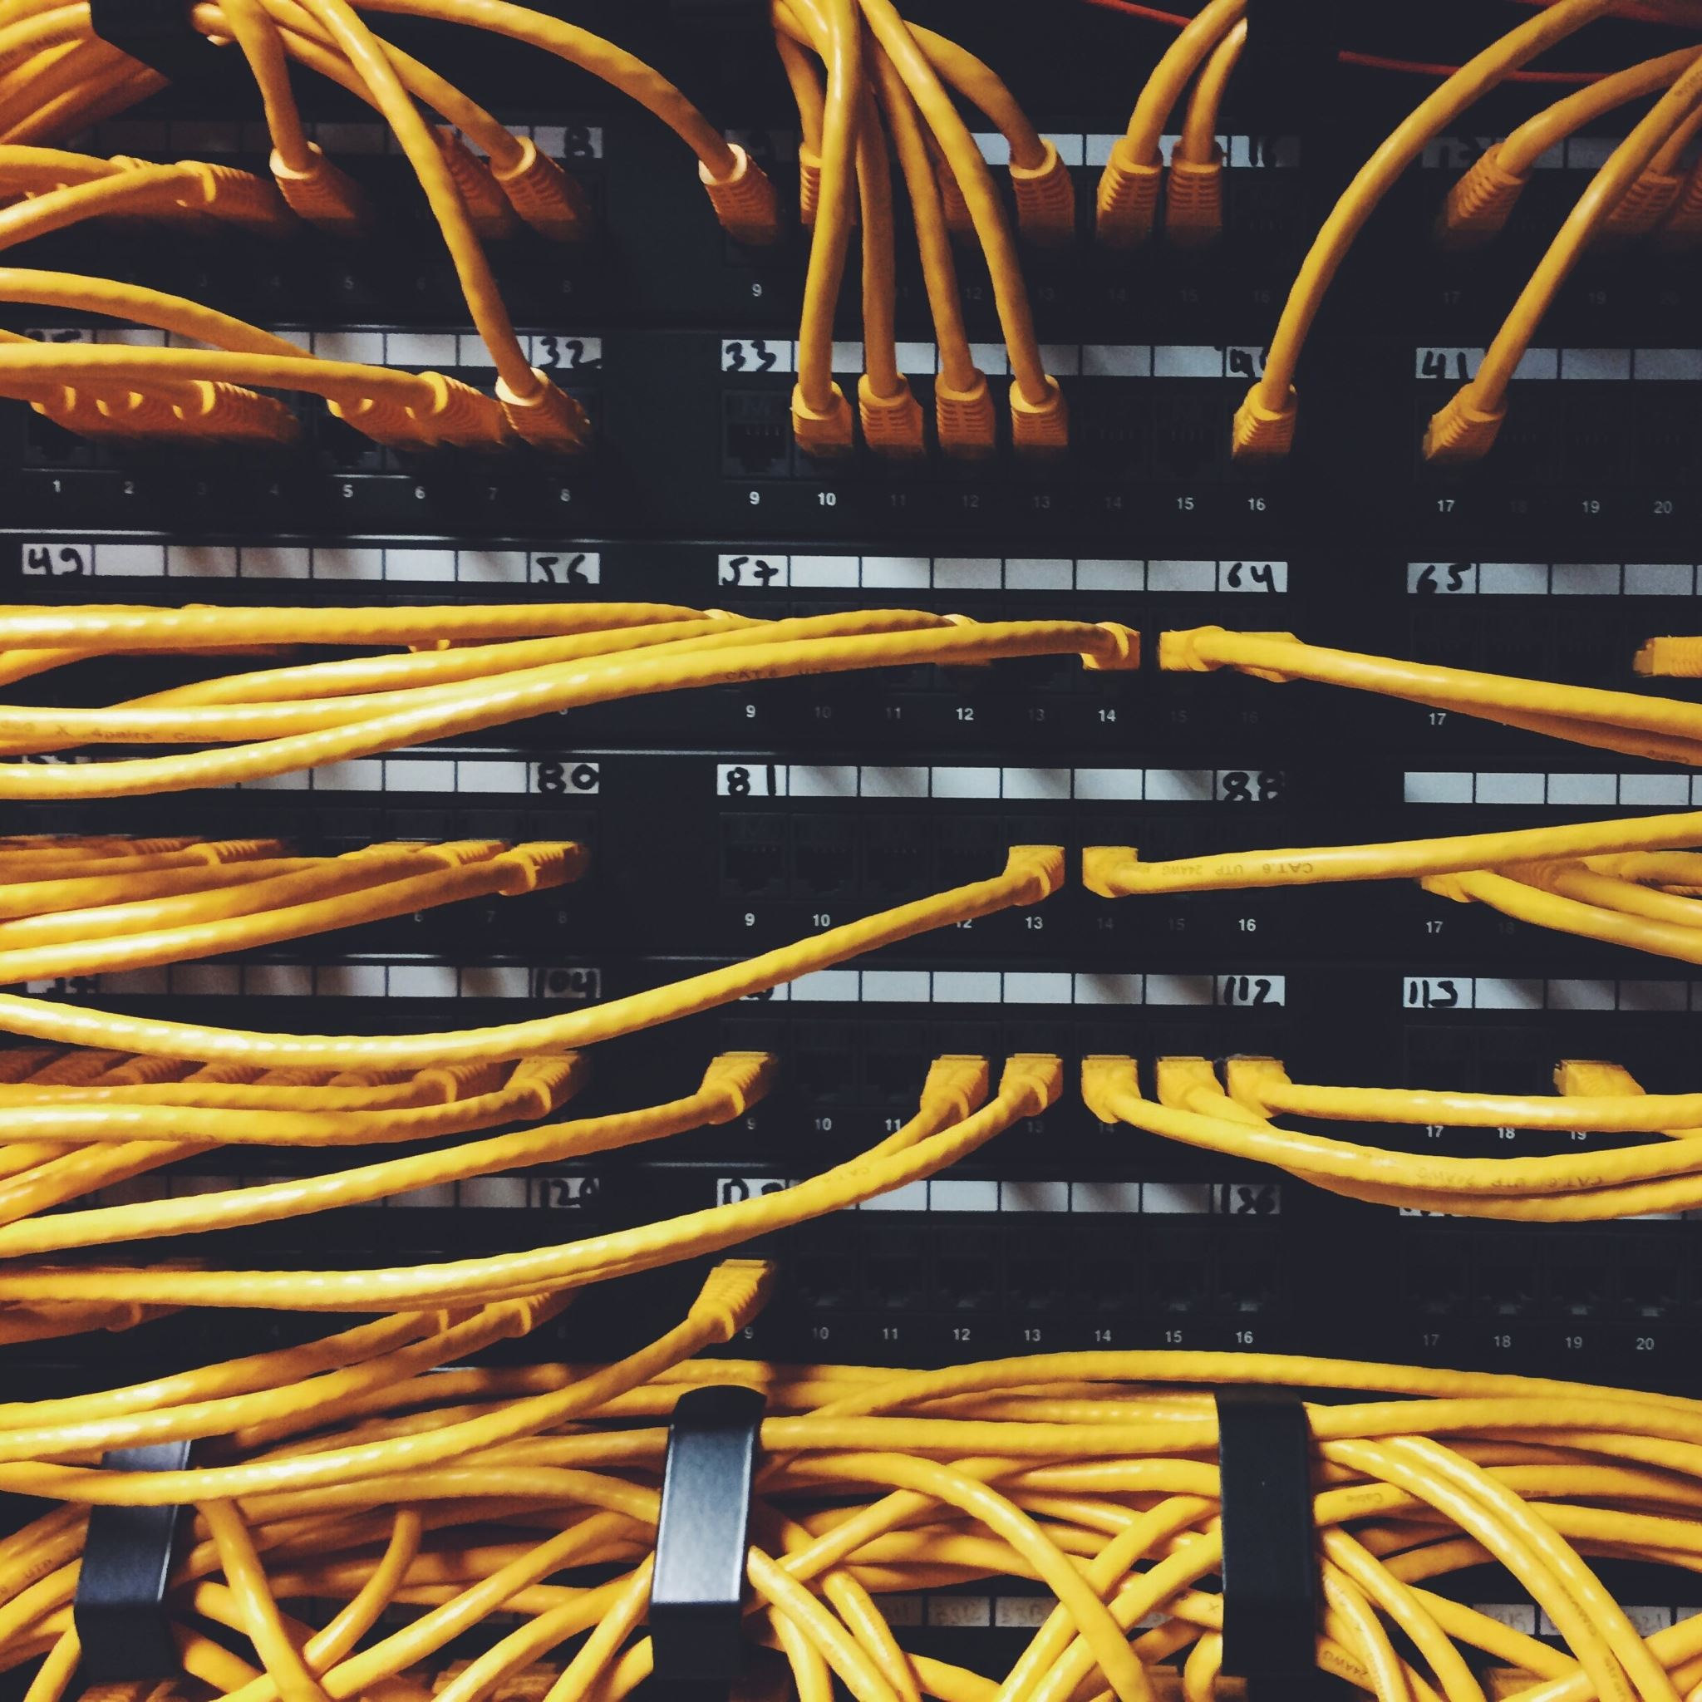
Next Lecture
Network Crimes
Computers network
Mobile Network (WiFi, Bluetooth, IR, etc)

Slide 13
End of Lecture

